Slide 1
Analysis of One Hour of Kalshi
Order-Book Activity
Exploratory data analysis and a five-minute prediction test
Syon Huang
ctrl-f5

Slide 2
Roadmap
PART 1 · EDA
PART 2 · MODEL
Terms and variable definitions
How concentrated activity is across 2,056 assets, and what the Gini coefficient measures
Timing, price and size patterns, including what prices indicate about probability
BUY/SELL balance and zero-size removals
Rebuild the order book from the update stream
Define the 5-minute mid-price target
How the two models were trained
Which features carry signal, and how the models score
Does the edge beat the spread

Slide 3
The hour at a glance
One hour of 2,056 separate streams of quote updates
628,513
2,056
10,475
update rows: order-book feed updates in the file
asset IDs: distinct contracts, each with its own stream of updates
updates per minute on average (about 175 per second)
Snapshot: one hour (23:00–23:59 UTC on Oct 9, 2026). It describes this particular sample, not Kalshi in general
Dynamics of a row: a quote being set, changed or removed. It is not necessarily a trade. A trader adjusting a resting order creates a row even though nothing was bought or sold.
Rate: 628,513 rows/60 minutes = 10,475 rows per minute, or about 175 rows every second across all assets combined
Unevenly shared: the average asset has about 306 updates but the median asset has only 44. The 100 busiest assets produce 410,208 rows and the other 1,956 assets share the remaining 34.7%.
Economics: this is order-book data, not a trade tape

Slide 4
Gini Ratio
Economic measure of inequality between a population
0.844 this hour
National income Ginis fall roughly between 0.25 and 0.65
0 = perfectly equal: every asset has about 306 updates
1 = one asset has all 628,513 updates
HOW IT IS CALCULATED
Structure
1. Rank : Firstly, we rank the 2,056 assets from fewest to most updates.
2. Accumulate: what share of all updates do the quietest 10%, 20%, 30% and so on of assets hold? Gini ratio is a way to answer that question
3. Interpretation:
At 0.844, an abnormal portion of the population has a larger distribution of the updates
Lorenz curve is the cumulative percentage of the population (ranked from least shares to most shares) on the x axis and the cumulative share of total income or wealth they earn on the vertical y axis
After computing the Lorenz curve, the ratio is given by A/A+B, where A is the area between this curve and the horizontal axis, and A + B is total area under equality line

Slide 5
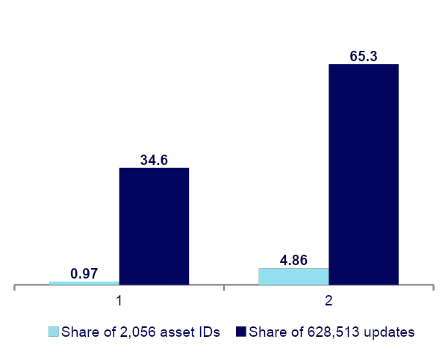
A few contracts carry the feed
Share of asset IDs versus share of all updates
Share of asset IDs vs share of updates (%)
0.844
Gini coefficient of update counts, close to 1 means very uneven
Top 20 assets (1.0% of the 2,056) account for 34.6% of all updates. The top 100 (4.9%) account for 65.3%.
Median vs busiest: the median asset has 44 updates and the busiest has 31,578, more than 700 times as many
Economic interp: Market is highly concentrated, with much more trades on a select few event contracts than others
Caution: pooled statistics give more weight to contracts with more quote updates, meaning the results mainly describe the most actively updated contracts and may not reflect the typical Kalshi contract

Slide 6
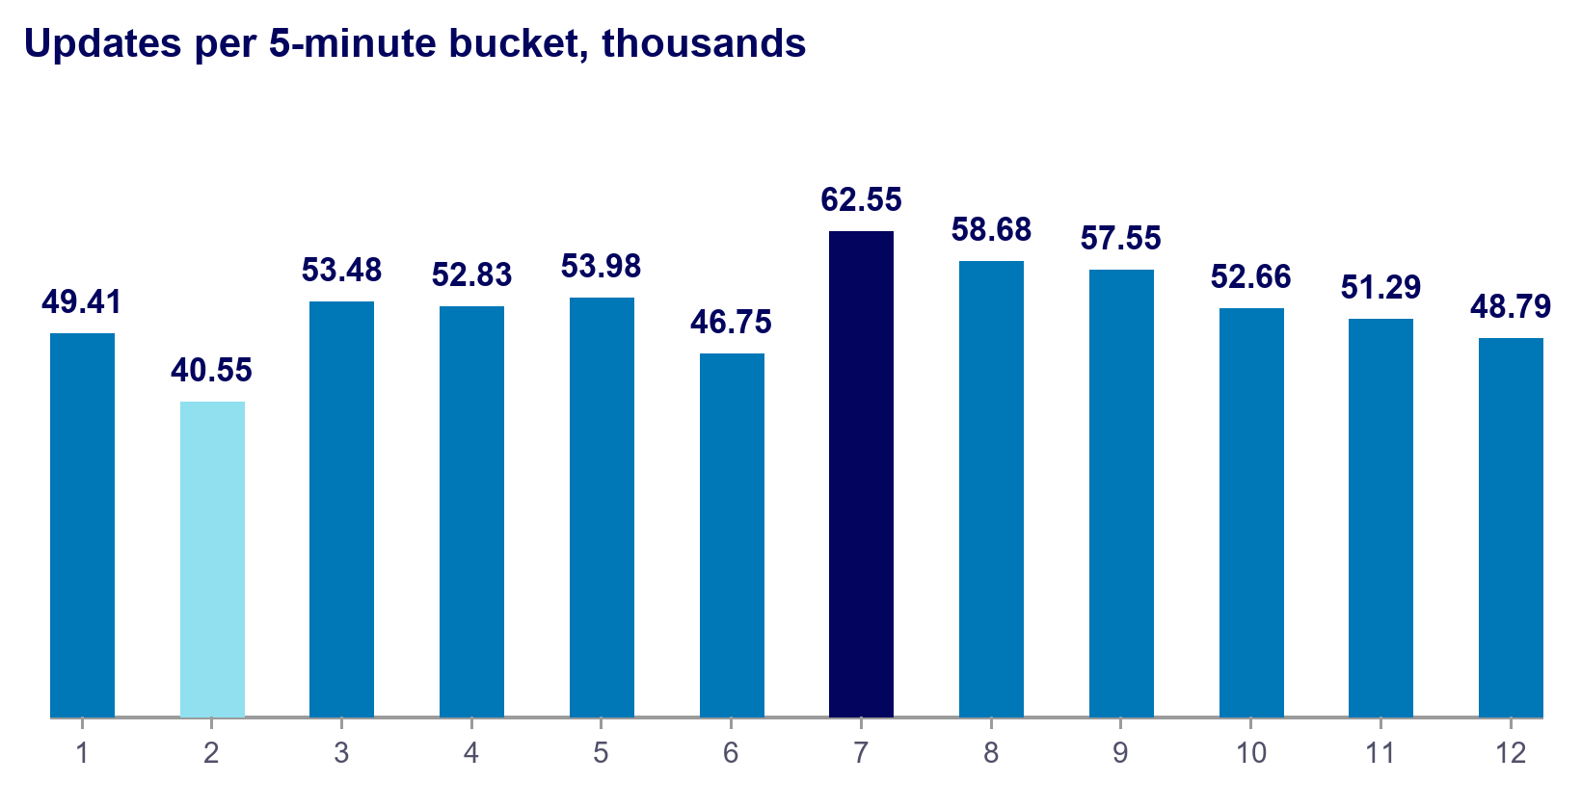
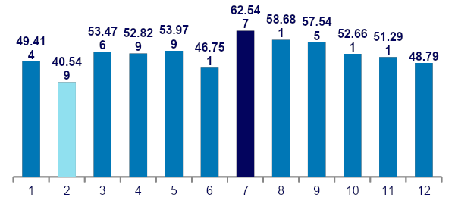
Activity is steady, with mild bursts
Even the busiest minute is only about 1.4× the average
WHAT THE NUMBERS SAY
15,014
7,252
Average: 628,513 / 60 = 10,475 updates per minute
Peak minute: 15,014 at 23:43 UTC, which is 1.43 times the average
Quietest minute: 7,252 at 23:06 UTC, 0.69× the average.
What 1.4× signifies: no minute strayed outside roughly 0.7× to 1.4× the average. A truly spiky feed would show peaks many times the average, so the update rate was relatively stable
5-minute totals run from 40.5k to 62.5k, or 0.77× to 1.19× the per-minute average
However, these are quote updates, not trades, so this measures how busy the book was. It is also the whole feed combined. Single assets can still be unpredictable
peak minute (23:43 UTC)
quietest minute (23:06 UTC)
Updates per 5-minute bucket, thousands

Slide 7
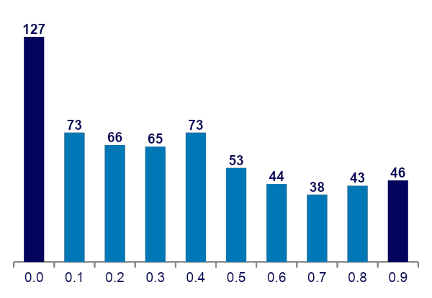
Prices read as probabilities
Reading the chart: each bar counts update rows priced inside a 0.1-wide bucket. Labels show the bucket start (0.0 means 0.00 to 0.10). Numbers above bars are thousands of rows and add up to 628.5k.
Shape: 127k rows (20.2%) sit below 0.10, then about 65k to 73k per bucket up to 0.5, and 38k to 52k per bucket above 0.5.
Mean 0.410, median 0.38. The middle half of quotes (25th to 75th percentile) sits between 0.14 and 0.63.
17.8% of updates are less than 0.05 or greater than 0.95: longshots and pretty much guaranteeds
In other words, people like to trade either extremely low probabilities or guaranteed payouts
Accurate reflection of trading mindset (?)
Updates by price bucket (thousands of rows)
Label = bucket starts, longshots (0.0 to 0.1) and near-certainties (0.9 to 1.0) are indicated with darker colors

Slide 8
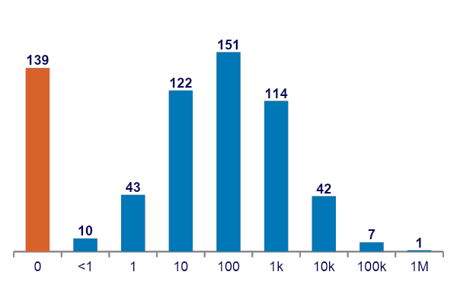
Sizes are heavy-tailed
A few huge quotes skew the average far above the typical size
Updates by size (thousands of rows)
Size - the quantity of shares posted, runs from 0 to over 10 million.
Example: 151,000 updates of 100-999 shares were made in our hour period
Typical sizes: the biggest non-zero bins are 100 to 999 (151k rows) and 10 to 99 (122k rows). Another 139k rows have size 0.
Median 101 vs mean 7,263. The 99th percentile is 117,818 and the maximum is 10,063,396
Heavy-tailed: Our data indicates extreme values are far more common than a bell curve, few giant quotes pull the mean far above the median
Also because negative values are impossible
Economic interpretation: depth is size resting at a price. Because of the tail, the median (101) shows typical depth and the mean overstates it once again
Label = bin start. “10” means sizes from 10 up to 100, and “1k” means 1,000 up to 10,000.

Slide 9
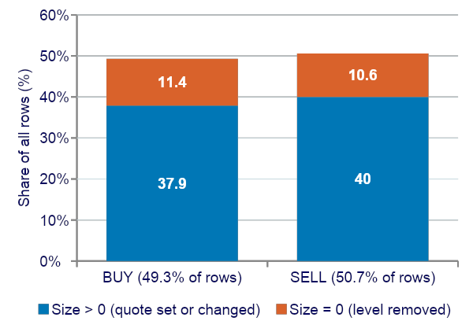
Balanced sides, and many removals
Zero-size updates are removals, so this is a quote stream and not a trade tape
Share of rows by side (%)
Balanced: BUY (label 0) is 49.3% of rows and SELL (label 1) is at 50.7%, so bids and asks are updated about equally often
Zero size: 23.2% of BUY rows and 21.0% of SELL rows, about 22% overall. Quantity at a price was pulled from the book.
Zero-size update: a row saying no quantity remains at that price, so the level is deleted. The file does not say if the owner cancelled or a trade filled it

Slide 10
ML Tool - Prediction Comparison
Q: Whether a unique asset_id's midpoint price at a certain time would be higher or lower after five minutes
Logic
99.7%
93
Each size is the new total at that price, not an amount added to what was there.
Select top active 100 order-book-update contracts
Skip crossed states, where the best bid is at or above the best ask. Our definition of a healthy market is contingent that best bid is below best ask
assets with usable features. 96 of the top 100 had more than 20 valid states
Most updated events’ best bid never exceeded lowest sell
median share of updates kept as valid book states (lowest asset: 13.1%)
1 · Replay
2 · Set or remove
3 · Read
4 · Sample each minute
Apply updates in time order, one asset at a time
Set the quantity at each bid or ask price, or delete the level if size is 0. Drop crossed states
Record the best bid, the best ask, and the size (quantity of shares at particular contract price) and depth posted near them
On a 1-minute grid, record mid-price, spread and imbalance per asset
Economics: the best bid and ask form the “touch”, essentially the best scenario where trades happen. Depth is the associated size posted near it

Slide 11
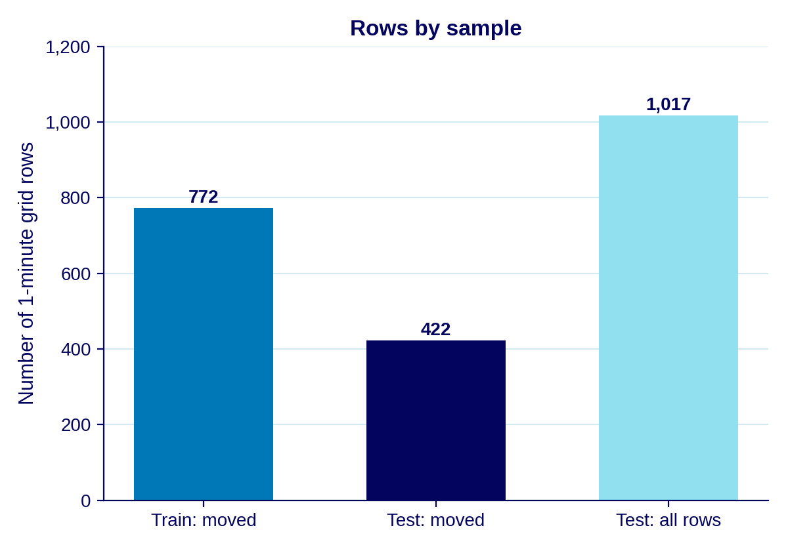
Target: the 5-minute mid-price move
Features on a 1-minute grid, scored on a holdout
Target: for each asset at grid minute t, the mid-price at t + 5 minutes minus the mid-price at t. For example: 0.40 now and 0.43 five minutes later gives +0.03, or +3 cents.
Moved rows are those where the target is not zero. 1,400 of 3,202 grid rows (44%) moved.
Direction is scored on moved rows solely, since a flat row has no direction
Predictors: imbalance, 1- and 5-minute returns, spread, volatility(standard deviation of changes over five minutes) and update count (updates in that minute), built from the book up to time t.
Split by time: the first 70% of rows train the models and the last 30% test them, with a 5-minute buffer between them to prevent the training target from overlapping the test period
Imbalance = (bid size − ask size) / (bid size + ask size). It runs from −1 (all asks) to +1 (all bids) and gauges buying versus selling

Slide 12
How the models were built and trained
Overarching split
5-min buffer
First 70%: training stage
Last 30%: testing stage
1017 rows
DATA AND TRAINING
Model selection
Data: only the grid rows built from this hour’s file
Training: Done on all moved rows
Held-out test: the models never see the last 30% of the time period while learning
Small sample: 772 training rows is little, so this tests whether a signal exists.
Both models are fitted to predict p(UP) or p(DOWN) during this stage
Logistic regression: a simple linear model weighing the 5 features, adds them up and converts the total into a probability of an up-move
Gradient boosting: Depth 3, iterations 150, learning rate 0.05, minimum samples 50, L2 = 1
Choice: logistic is rough benchmark, attempt boosting with additional complexity.

Slide 13
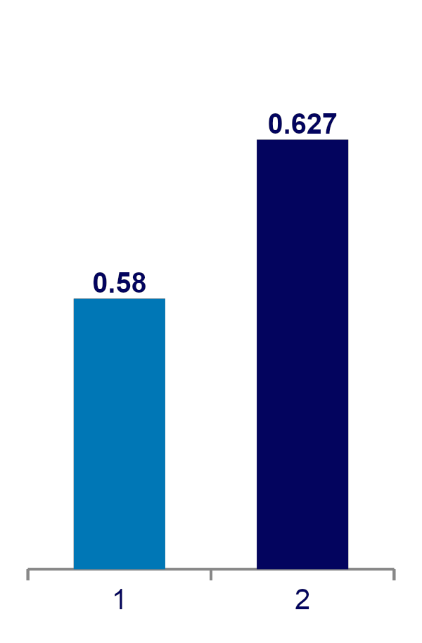
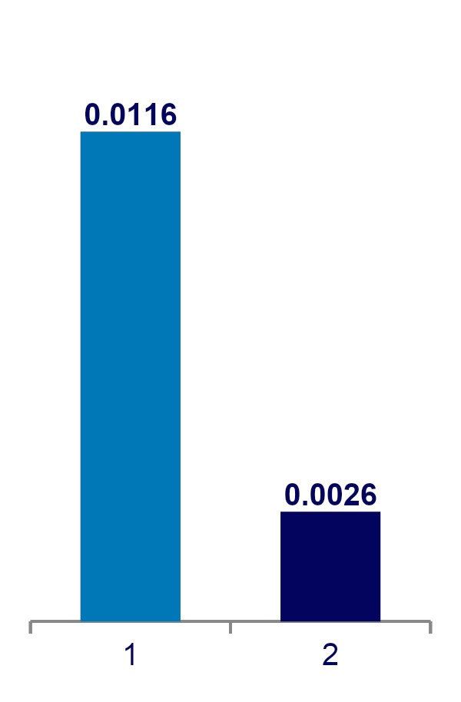
Both models rank moves above chance
Did P(up) rank actual up-moves above actual down-moves?
AUC
Log loss gain over the 0.693 baseline
AUC: chance that a randomly chosen up-move gets a higher predicted P(up) than a randomly chosen down-move. 0.50 is a coin flip and 1.00 is perfect, logistic scores 0.580, boosting 0.627.
95% intervals: logistic 0.530–0.627, boosting 0.572–0.679. Both beat chance, but they overlap, so boosting is not proven better
Accuracy: 55.5% logistic and 58.3% boosting. Always guessing “down” would score 50.9%
Log loss grades the probabilities and punishes confident wrong calls. 0.693 is what a constant 50/50 guess scores. Logistic beats it by 0.0116, boosting by 0.0026.
Takeaway: boosting ranks better, but it's probabilities are barely better calibrated than 50/50

Slide 14
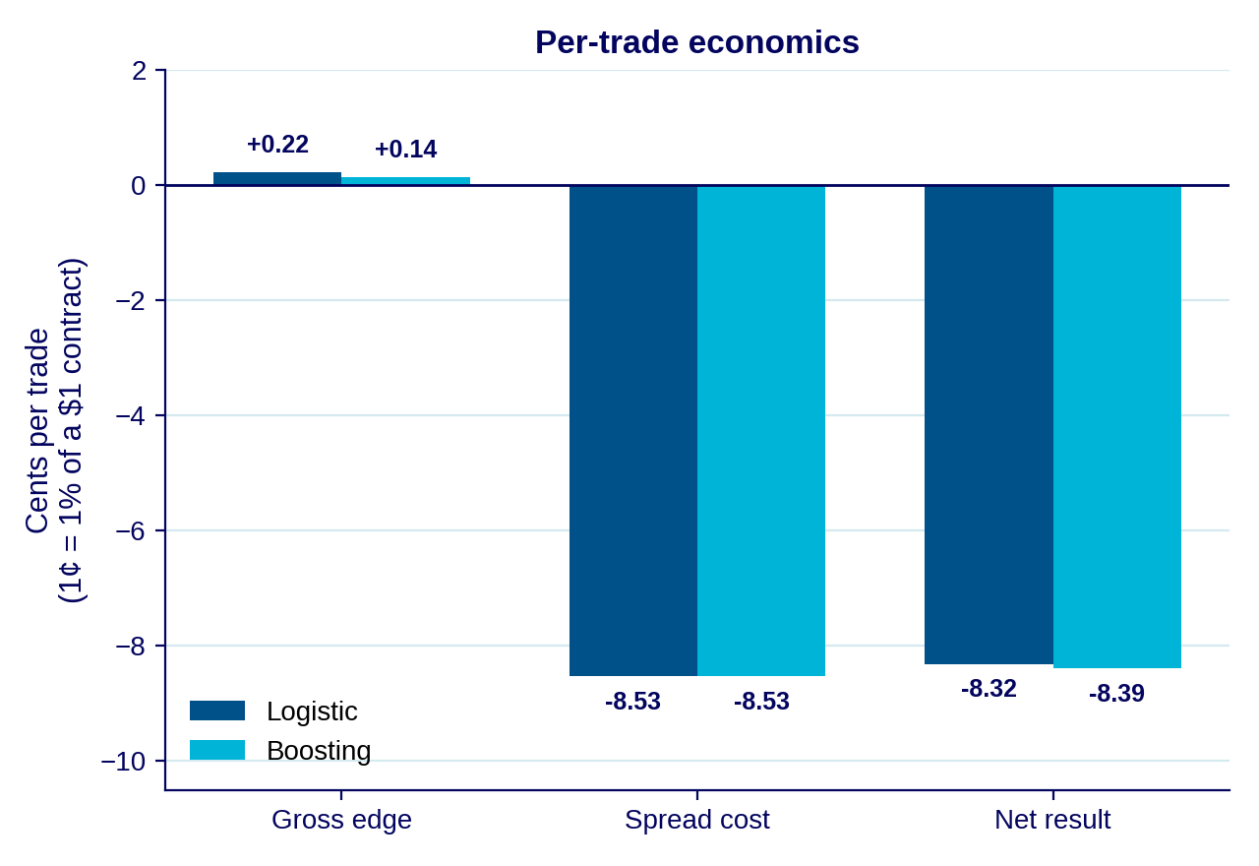
Economic Test: Trading Rule
If we acted on P(UP), how much would we have made?
Rule: Utilize all test rows, buy YES if P(up) > 0.5, otherwise buy NO. Close after 5 minutes. A NO position gains when the YES price falls.
Units: 1% of a $1 contract.
Gross edge: direction bet on * actual 5 minute mid-price move,, +0.22c per trade (logistic) and +0.14c (boosting), which represents the average profit
Cost: spread at entry + spread at exit / 2, roughly 8.53 cents a trade (evaluated at test) at 5 minute intervals
Net: −8.32c (logistic) and −8.40c (boosting) per trade.

Slide 15
Conclusions
Descriptive evidence from one hour and 93 active assets
To Sum
Possible future directions
The model predicts direction only. We then ask whether acting on that prediction (previous slide) would have paid, using the real price changes and real spreads
Activity is concentrated: Gini 0.844, and the top 100 assets produce 65.3% of rows.
The update rate was steady: the busiest minute was only 1.4× the average.
Prices span 0 to 1, sizes are heavy-tailed, and about 22% of rows are removals.
Both models, trained on this hour, rank moves slightly above chance (AUC 0.58 and 0.63).
No tradable edge: at most 0.22 gross against an 8.53 spread cost.
Low data usage - more variety in data could lead to better predictions
One hour only: nothing about other days or events, and only few training rows.

Slide 16
Questions?

